Slide 1

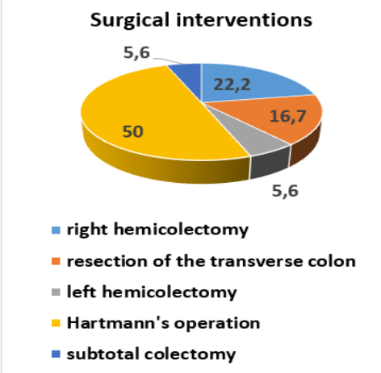
Features of colorectal cancer complicated by peritonitis
Olga Bilyaeva*1, Ivan Karol*1, Volodymyr Andriiets*2
1*Surgery, Shupic National University of Health of Ukraine, Kyiv
2*Surgery, BROVARY HOSPITAL, Brovary, Ukraine
PURPOSE / OBJECTIVES
Colorectal cancer is a serious problem that is difficult to treat, and when it is complicated by peritonitis, patients' chances of survival are greatly reduced.
RESULTS
The aim of the study was to elucidate the features of colorectal cancer complicated by peritonitis.
MATERIAL & METHODS
During the period from 2017 to 2020, 18 patients with colorectal cancer complicated by peritonitis were operated at Brovary Multidisciplinary Clinical Hospital. There are 14 men among them (77,8%), 4 women (22,2%). Tumor localization: ascending colon - 1 (5,6%) case, hepatic angle - 2 (11,1%) cases, transverse colon - 4 (22,2%), spleen angle - 2 (11,1%) ), sigmoid colon - 8 (44,4%), rectosigmoid connection - 1 (5,6%) case.
RESULTS
Common forms of peritonitis were observed in all patients: diffuse - in 5 (27,7%) patients, widespread - in 10 (55,6%) and general - in 3 (16,7%) patients. Reactive stage of peritonitis was in 4 (22,2%) patients, toxic - in 10 (55,6%) and terminal - in 4 (22,2%) patients. By the nature of the exudate in the abdominal cavity in 7 (38,9%) cases peritonitis was serous-fibrinous, in 4 (22,2%) - fibrinous-purulent, in 6 (33,3%) - fecal and in 1 (5,6%) of hemorrhagic cases. The patients underwent the following surgical interventions: right hemicolectomy - in 4 (22,2%) cases, resection of the transverse colon - in 3 (16,7%), left hemicolectomy - in 1 (5,6%), Hartmann's operation - in 9 (50,0%), subtotal colectomy - in 1 (5,6%) case. Repeated surgical interventions were performed in 4 (22,2%) patients. In the postoperative period, the following complications were observed: suppuration of the wound - in 2 (11,1%) cases, abdominal abscess - in 1 (5,6%) case, eventration - in 3 (16,7%) cases. The Mannheim index of peritonitis in all patients was grade III. 3 (16,7%) patients died.
SUMMARY / CONCLUSION
Peritonitis, which has complicated the course of colorectal cancer, significantly worsens the prognosis of the disease, necessitates urgent surgery and causes high mortality, which according to our data in the postoperative period was 16,7%.

